Slide 1

The Scrum-Agile approach
By: Tevaen Kenerly

Slide 2
Let's compare and contrast the waterfall methodology to the agile methodology
Similarities
Waterfall
Agile
- Linear and sequential process
- Consist of phases and stages
Documentation
Stakeholder involvement
Quality focus
- Structured approach
- Iterative and flexible
Limited client involvement
- For stable and well-defined
Requirements
Difficult for changes during
Development
Testing occurs only after entire
Product is developed
- Predictable
Continuous client collaboration
Suitable for evolving requirements
Great flexibility
Frequent testing throughout development
Testing occurs after each sprint
- Lack predictability

Slide 3



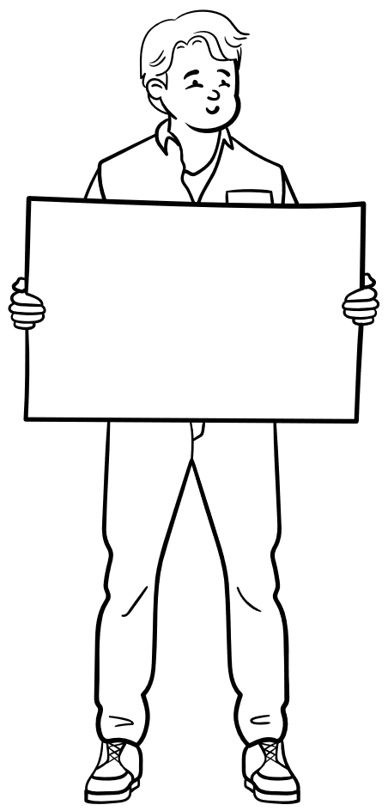
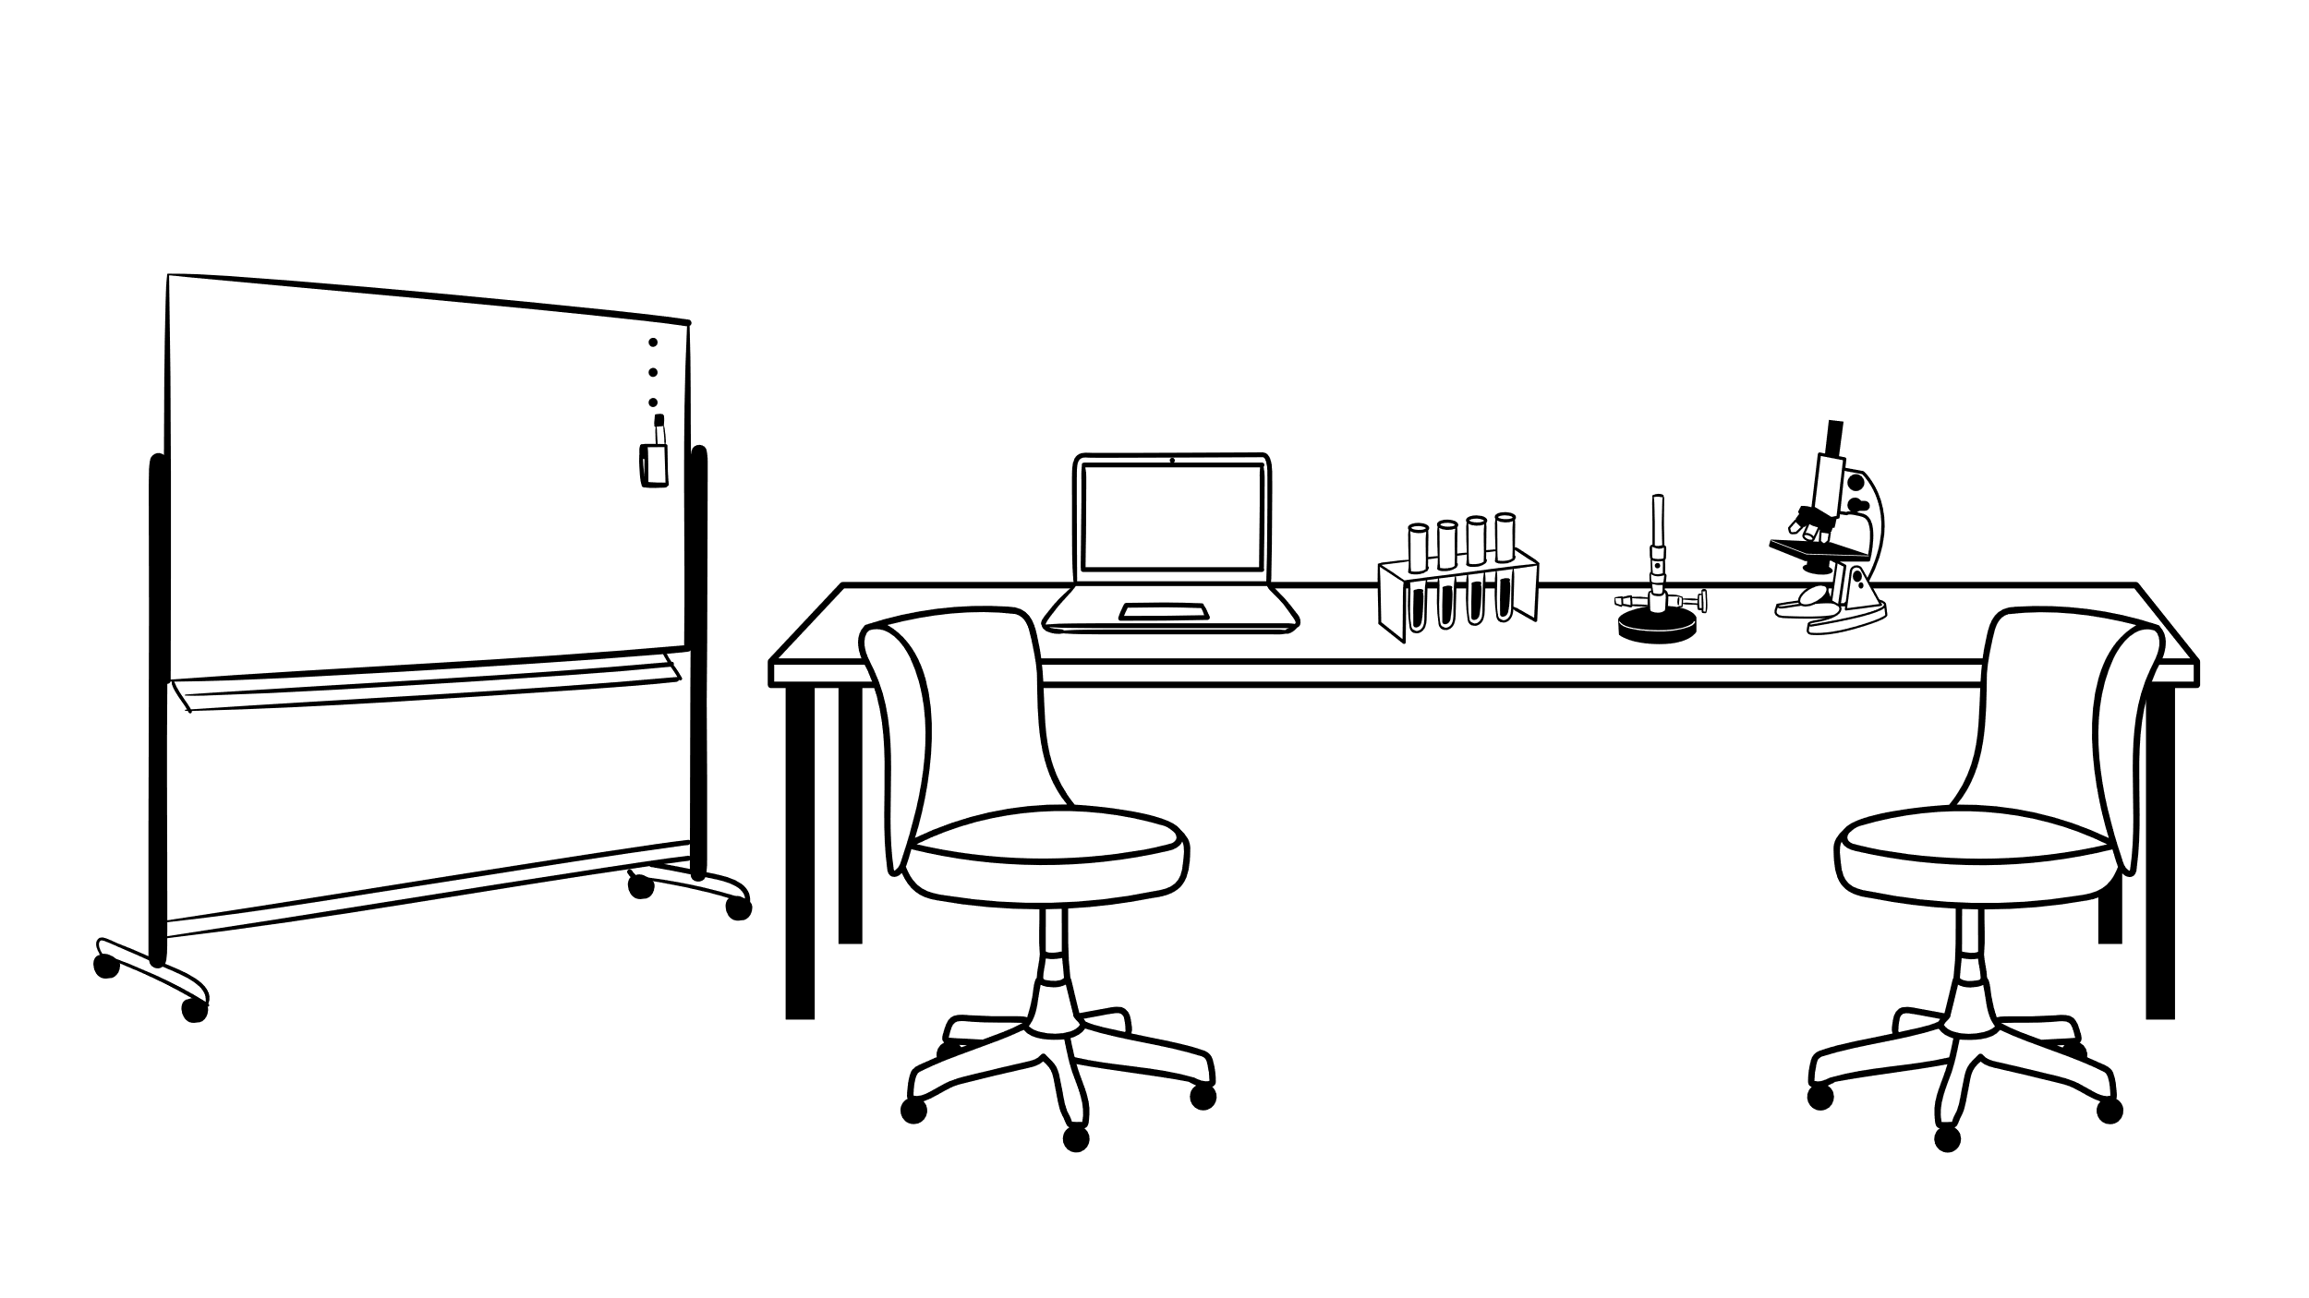
Product backlog
----------------------
User stories
------------------
Backlog refinement
------------------
Scrum-Agile approach
The scrum agile approach is used to provide flexibility and promote teamwork and collaboration
Can we add more?
I need help
Daily standups
----------------------
Sprint planning
-----------------------
Sprint reviews
----------------------
Feedback
Collaboration
Communication

Slide 4
Agile phases
Requirements
------------------------
Using a product backlog and user stories
This captures customers needs through collaborative
Story writing and prioritizing
Design
-----------
Sprint planning and technical design is used to focus on the design to start building the product
Requirements
Design
Collaboration
Implementation
-------------------------
Using sprint execution and daily stands ups
Constant communication and
Task/requirement updates while writing code in cycles
Testing
-----------
Using unit testing and sprint review
Features are validated during and after each sprint
Implementation
Testing
Adaptability
Transparency
Deployment
-------------------
Using incremental releases and demos to stakeholder
Working software is presented at the end of each sprint
Deployment
Maintenance
Maintenance
--------------------
Using backlog refinement and more testing
Feedback is used for ongoing improvements

Slide 5
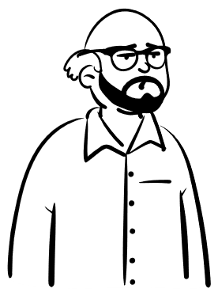


Agile Roles
Product Owner
Scrum Master
Why am I important?
Why am I important?
Bridges the gap between business and tech.
Directs and leads the team to ensure smooth collaboration.
Defines the product vison.
Facilitates scrum practices and coaches the team.
Developer
Why am I important?
Why am I important?
Tester
Hands on creator, without them, there is no product.
Advocate for quality and help catch issues early
Builds, test, and delivers increments of the product.
Ensures the system meets full functionality and expectation.

Slide 6
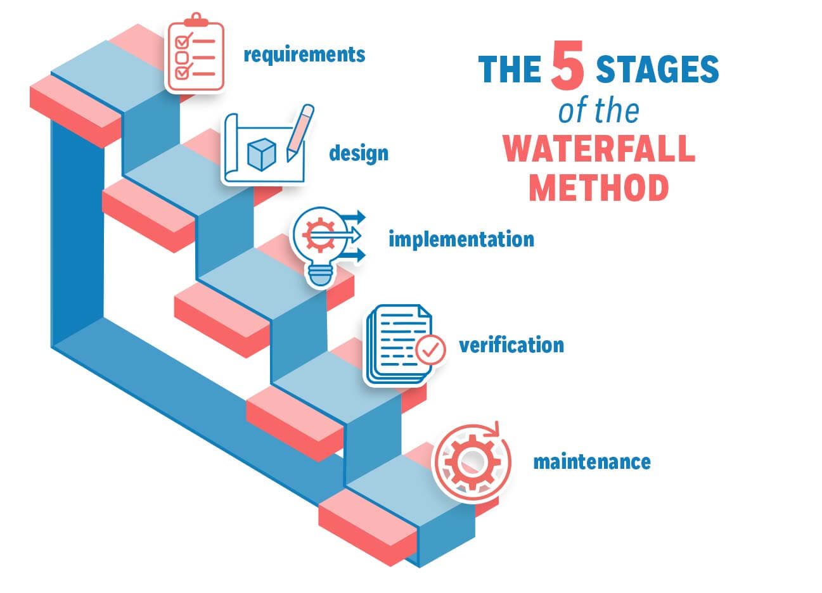
What if we used the waterfall approach?
With the waterfall approach not allowing for refinement, demos, much communication, feedback, or flexibility. During our testing phase we would not be able to go back and ask for clarification on a feature and then go back into development to implement it.

Slide 7
So… Waterfall or Agile?
When choosing between agile and waterfall it really depends on the projects needs
Waterfall
Agile
Waterfall is good for projects with clear and stable requirements
Agile is flexible
Suited for projects with evolving requirements
Offers structured planning and clear milestones
Allowing for continuous improvement and faster delivery
The choice comes down to which suits your current project the best. This decision should consider things such as project scope, timeline, team dynamics, customer requirements, structured or flexible, stable or evolving, predictable or unpredictable. These factors along with your company or team standards should all be evaluated in your decision between waterfall or agile.

Slide 8
References
Donato, H. (2025, June 27). What are the phases of Scrum? Workamajig. What Are the Phases of Scrum?
GeeksforGeeks. (2025, July 23). Agile vs Waterfall Project Management Agile vs Waterfall Project Management – GeeksforGeeks
Institute of Project Management. (2022, May 20). What is Waterfall Methodology: Everything you need to know. What is Waterfall Methodology: Everything You Need to Know | IPM
Quick, L. (2025, February 14). Top 21 Scrum best practices for efficient Agile workflow. KnowledgeHut. Top 21 Scrum Best Practices for Efficient Agile Workflow

